Slide 1



Paper ID:1610 Paper Title:
WEB ENABLED FINGERPRINT BASED ELECTRONIC VOTING MACHINE FOR PRIVATE COMMUNITIES
International Conference on Artificial Intelligence and Sustainable Innovation 2025 (ICAISI-2025)
Presented By:
Brijesh Nishad (2101321550026)
(Department of CSE-IoT , GNIOT Greater Noida,India)

Slide 2
Table of Contents
Introduction
Related Work
Proposed Methodology
Experiments and Results
Conclusion and Future Scope

Slide 3
Introduction
Voting is crucial for democratic processes even in small communities
Traditional voting methods are prone to fraud and inefficiencies
Lack of automation leads to time delays and human errors
Biometric systems help verify identity with high accuracy
Web-based systems improve transparency and result access
Integration of both enhances trust and efficiency in elections

Slide 4
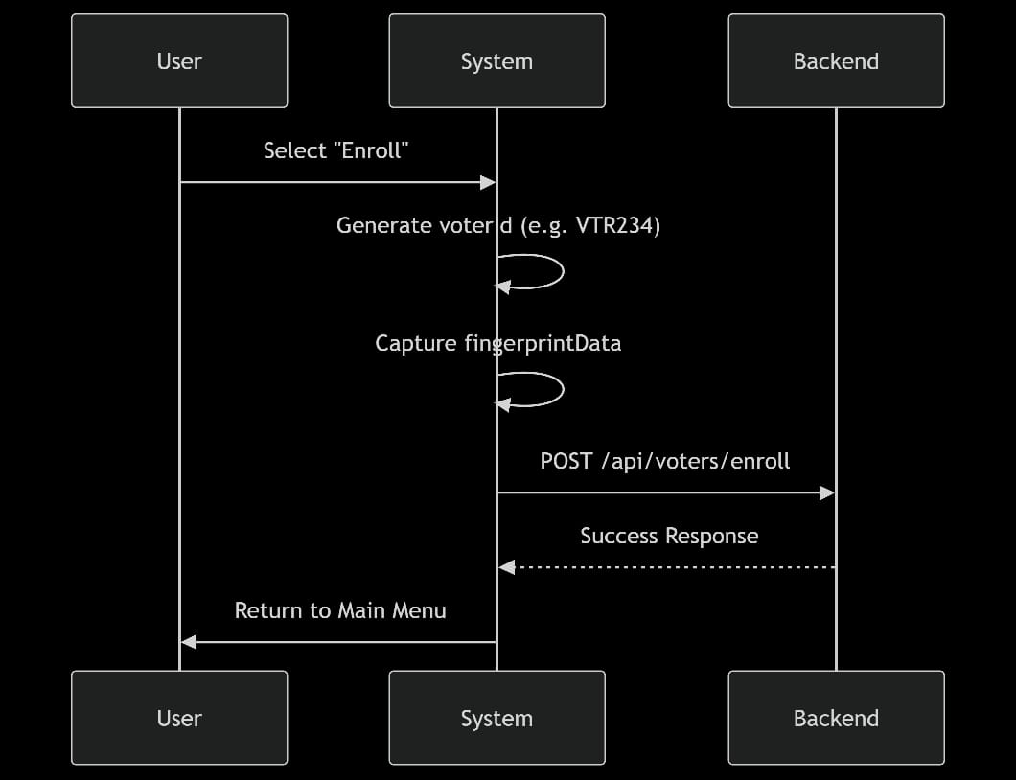
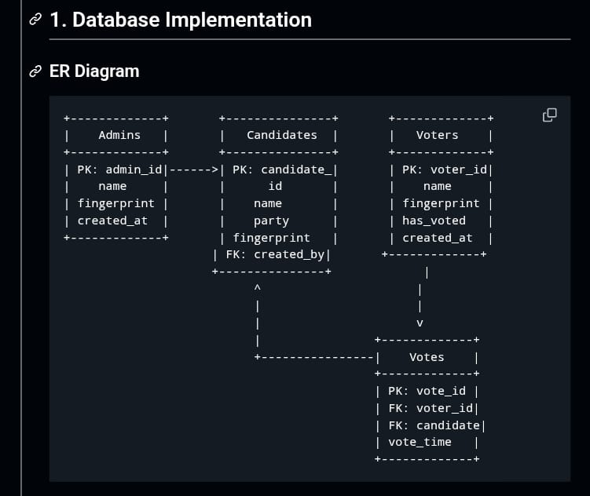
Flow Diagram

Slide 5

Literature Review (Related Work)
Traditional paper and EVMs lack biometric verification
Some systems use biometrics but are not web-enabled
Online voting platforms often lack secure ID verification
Existing systems suffer from data security issues
Limited use in private, local community settings
High cost and complexity limit adoption

Slide 6
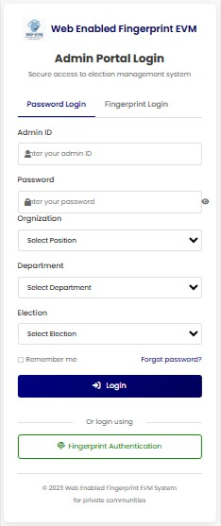
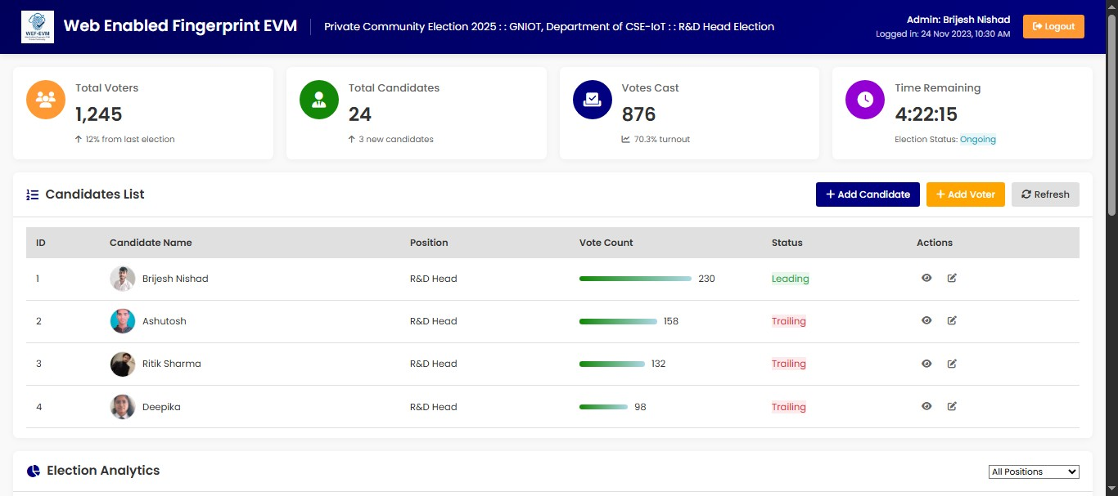
Proposed System Overview
Dashboard
Admin Portal Login

Slide 7
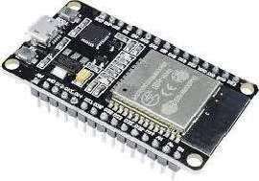
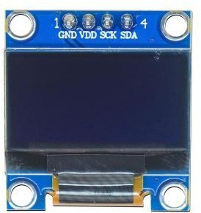
Hardware Components
ESP32 OLCD Module
Built-in Wi-Fi
Low Cost
Open source
Community and Library Support
Alphanumeric Display 16x2 Format
Parrallel Communication Low Power Consumption

Slide 8
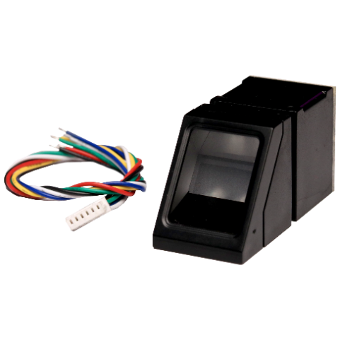

Fingerprint Scanner
LED
Finger print scanner
Collection of Data
High Senstivity
Low Cost
Shows system power/status
Indicates successful fingerprint scan
Alerts for invalid votes
Blinks during vote casting
Green = Success, Red = Error

Slide 9
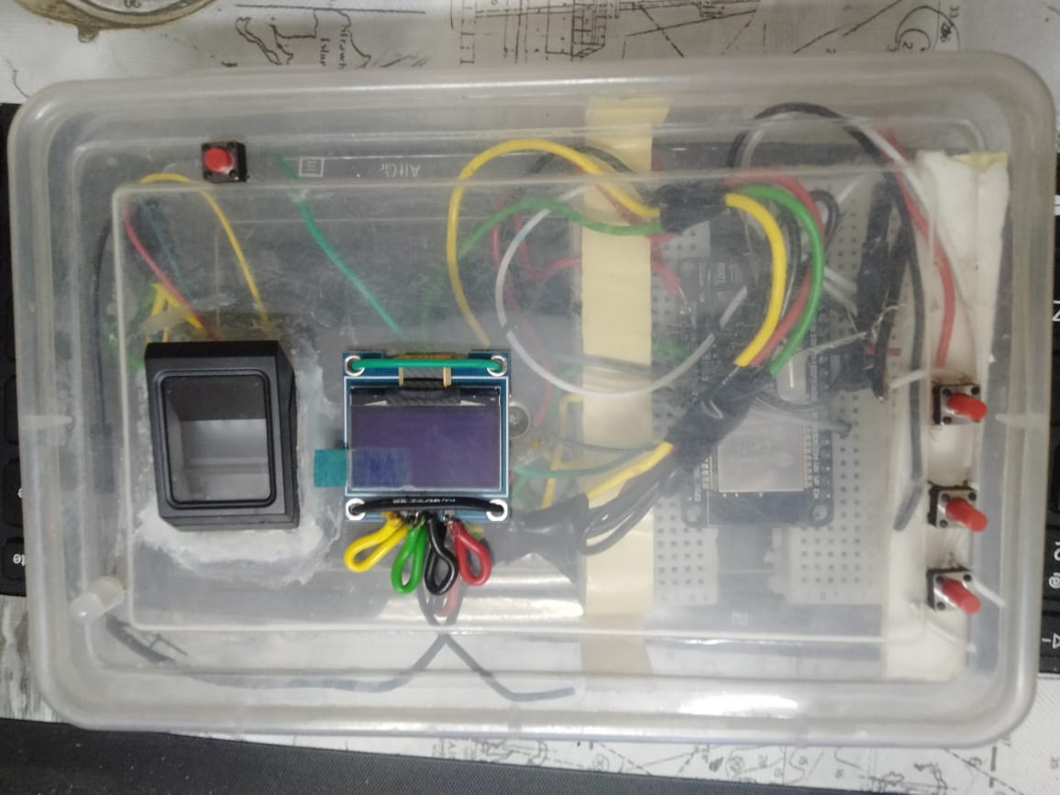
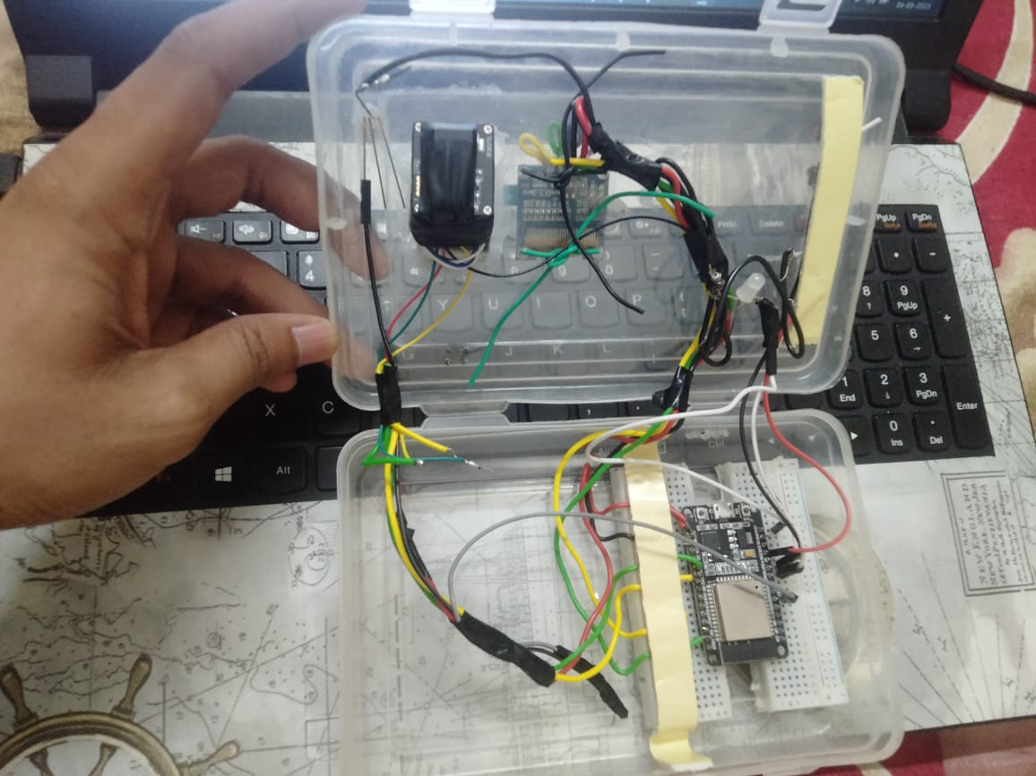
Hardware interfacing

Slide 10
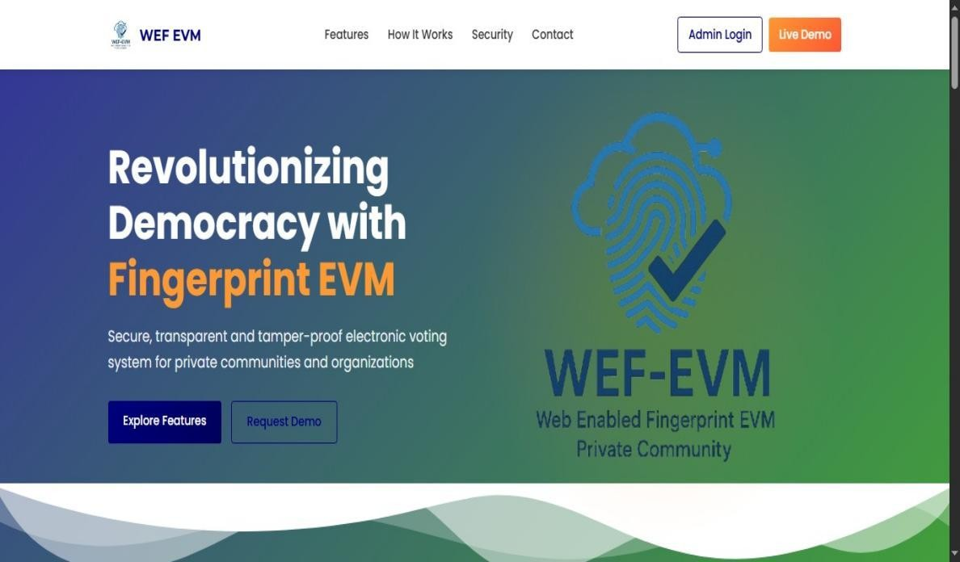
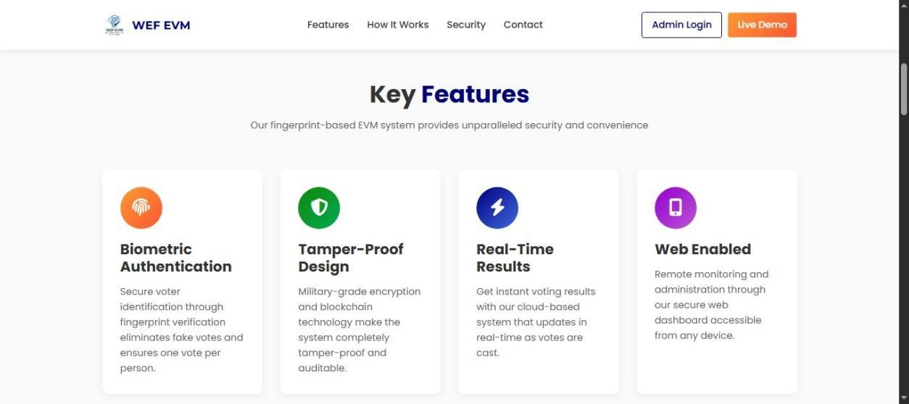
Software Components
Admin Home Page 1 Features Home Page 2

Slide 11
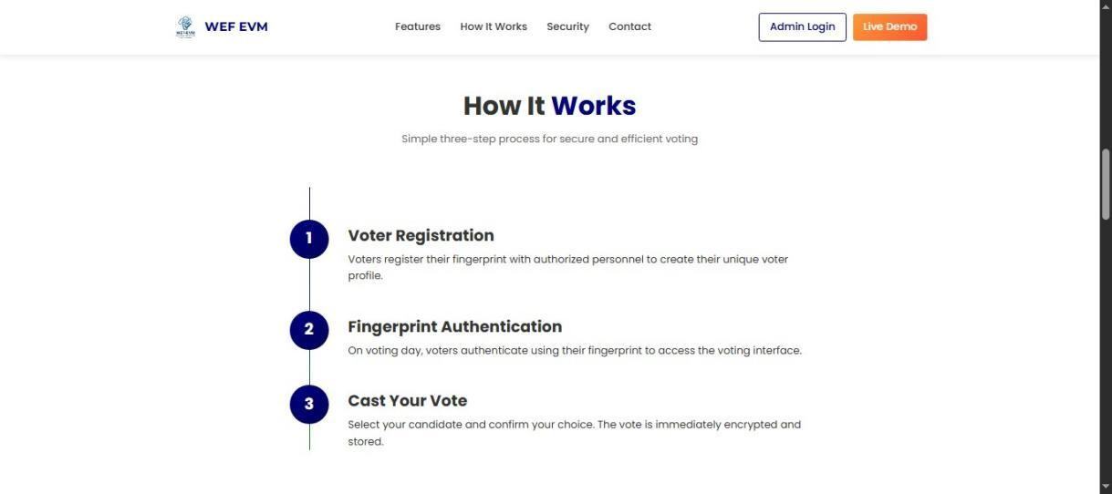
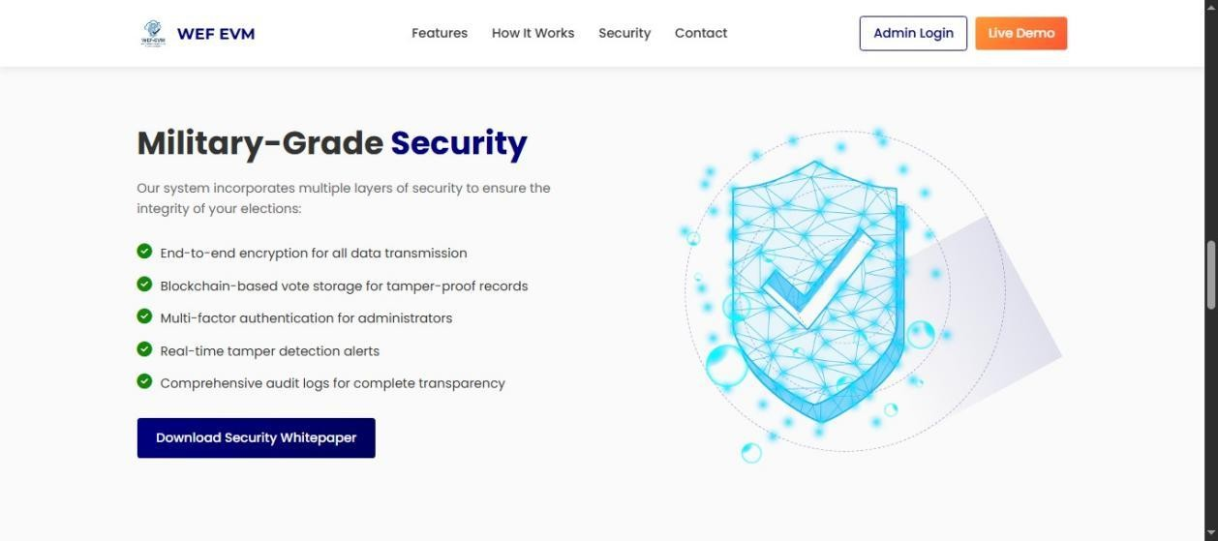
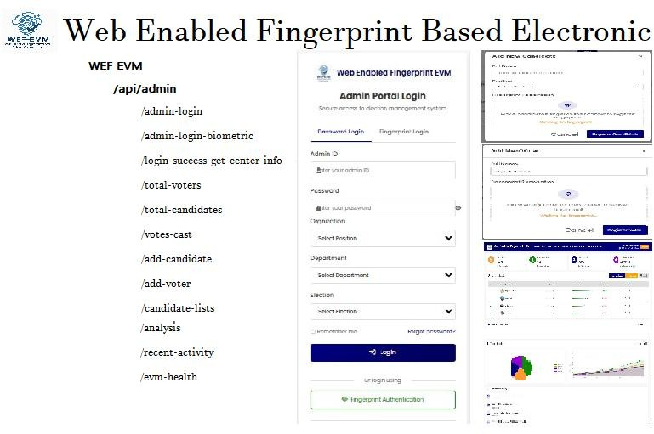
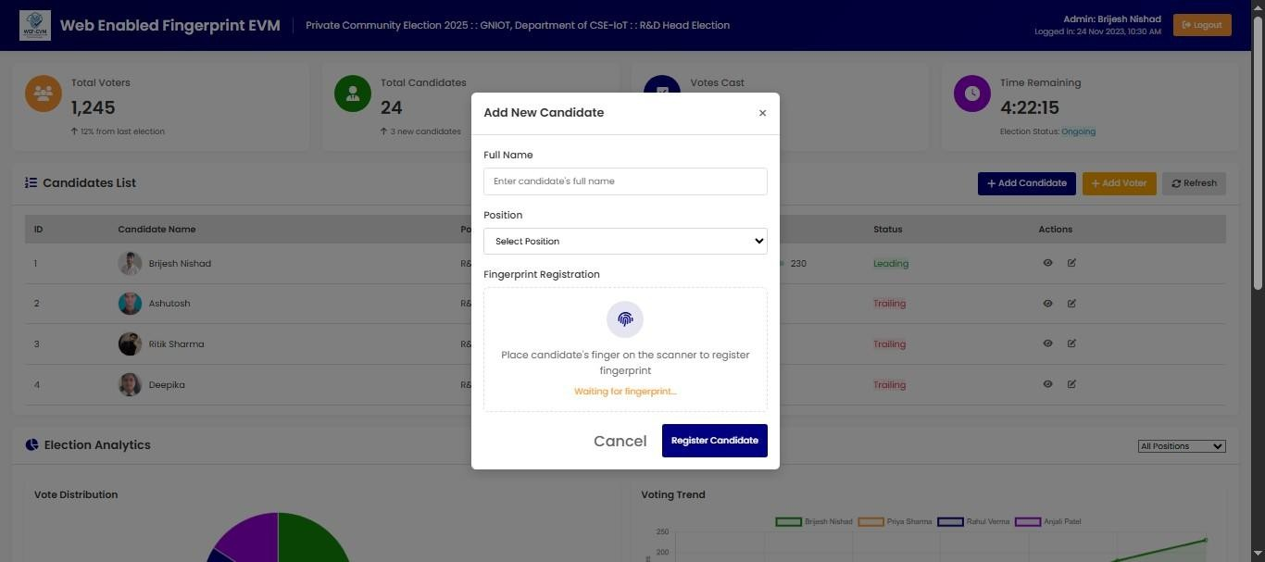
Working Process Home Page 3 Security Home Page 4
Api – Integration candidate & voter register

Slide 12
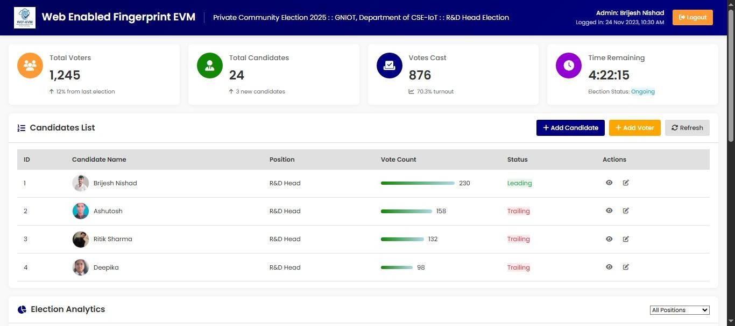
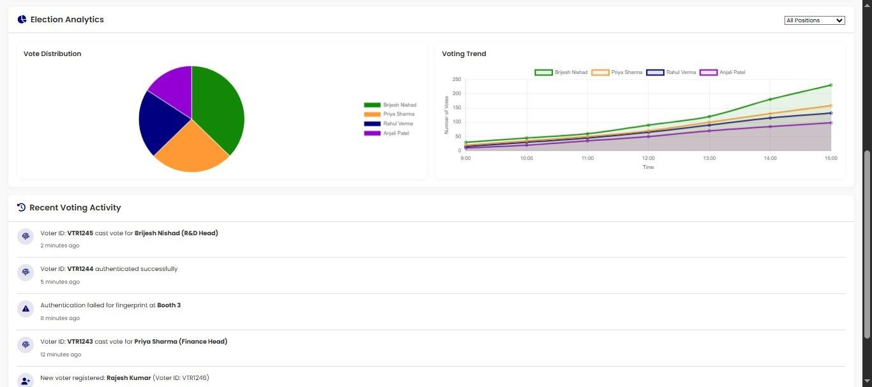

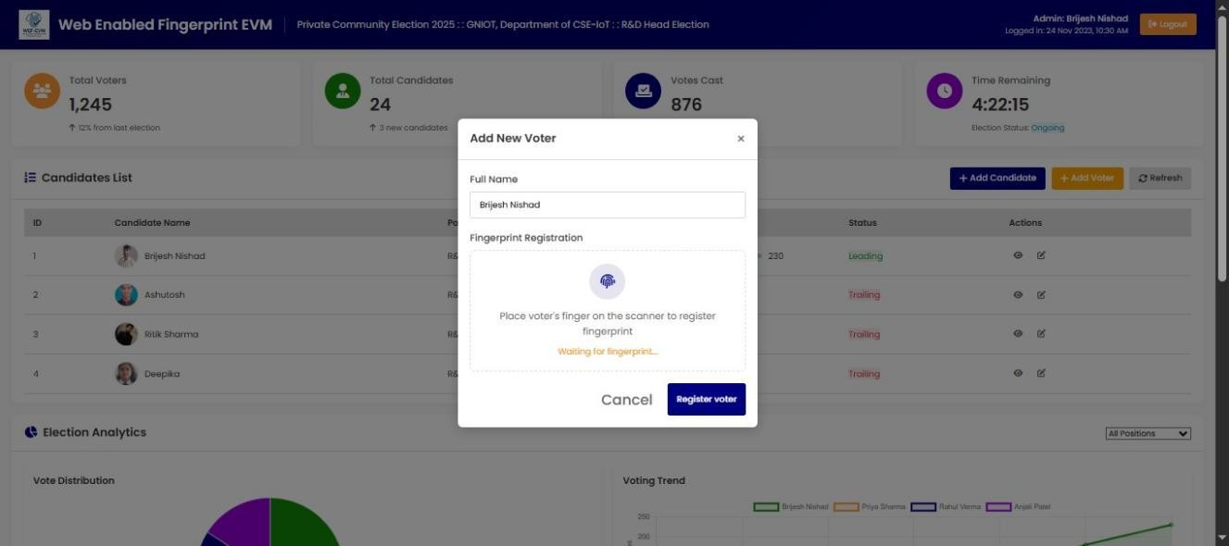
Election-analysis
Dashboard
logo
voter- register

Slide 13
Experimental Setup
Voting Prototype: Built using Arduino/ESP32 with integrated biometric and connectivity modules.
Test Environment: Simulated voting conditions with multiple users, fingerprint verification, and vote casting scenarios.
Power Supply: Stable power setup ensures continuous operation of sensors and system components.
Test Scenarios:
Valid and invalid fingerprint input
Multiple voting attempts
Real-time web result updates
Wi-Fi disconnection and reconnection
Admin result access from remote device

Slide 14
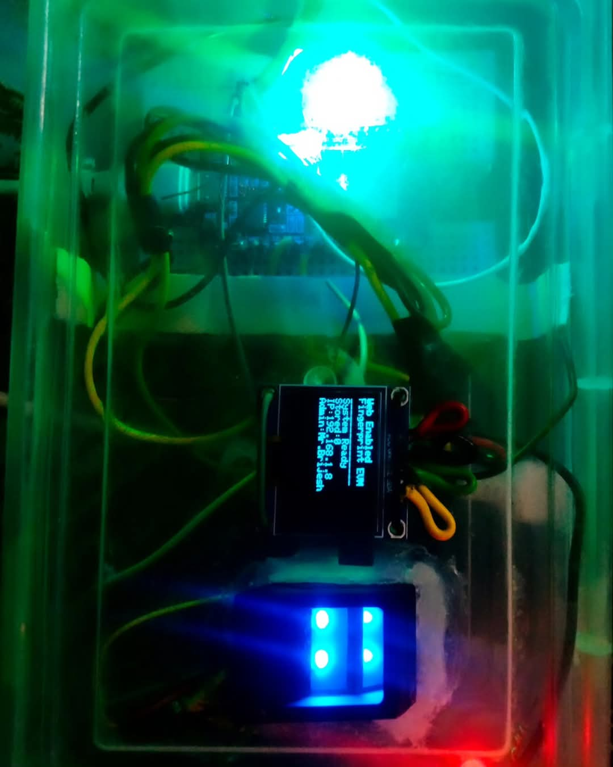
Results & Discussion
Effective Monitoring: Fingerprint sensor accurately verifies voter identity to prevent fraud.
System promptly indicates invalid fingerprints or multiple voting attempts via LEDs.
Web Advantage: Enables real-time remote monitoring of votes and instant result updates through the web dashboard.

Slide 15
Conclusion
The web-enabled fingerprint voting system improves election security through real-time voter authentication.
Accurately verifies voter identity, preventing unauthorized or duplicate votes.
Provides fast, local alerts (LED/buzzer) and remote notifications via the web dashboard for administrators.
Future deployment in real private communities will validate practical effectiveness and user acceptance.

Slide 16
Thank You

